Slide 1
Progress of X-Band Accelerating Structures
LINAC10, Tsukuba
17 Sep. 2010
T. Higo (KEK)

Slide 2
Contents
Evolution in 20 years
Judgment with breakdown rate
Supplemental high-gradient studies
Effort with parameter optimization
for stable high gradient
Effort with other HOM damping scheme
Efforts in fabrication technology
X-band collaboration

Slide 3
Evolution of LC structures in 20 years

Slide 4
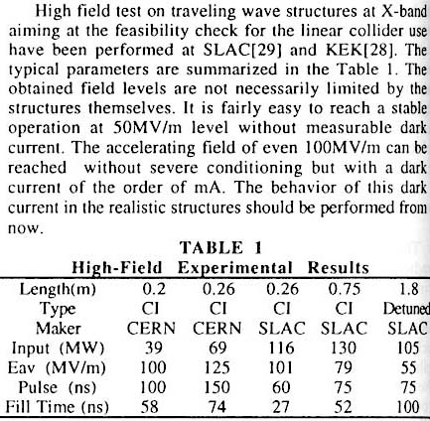

LINAC94 at Tsukuba “Linear Collider Structures”
16 years ago, the beginning
Discussed 100 MV/m level.

Slide 5
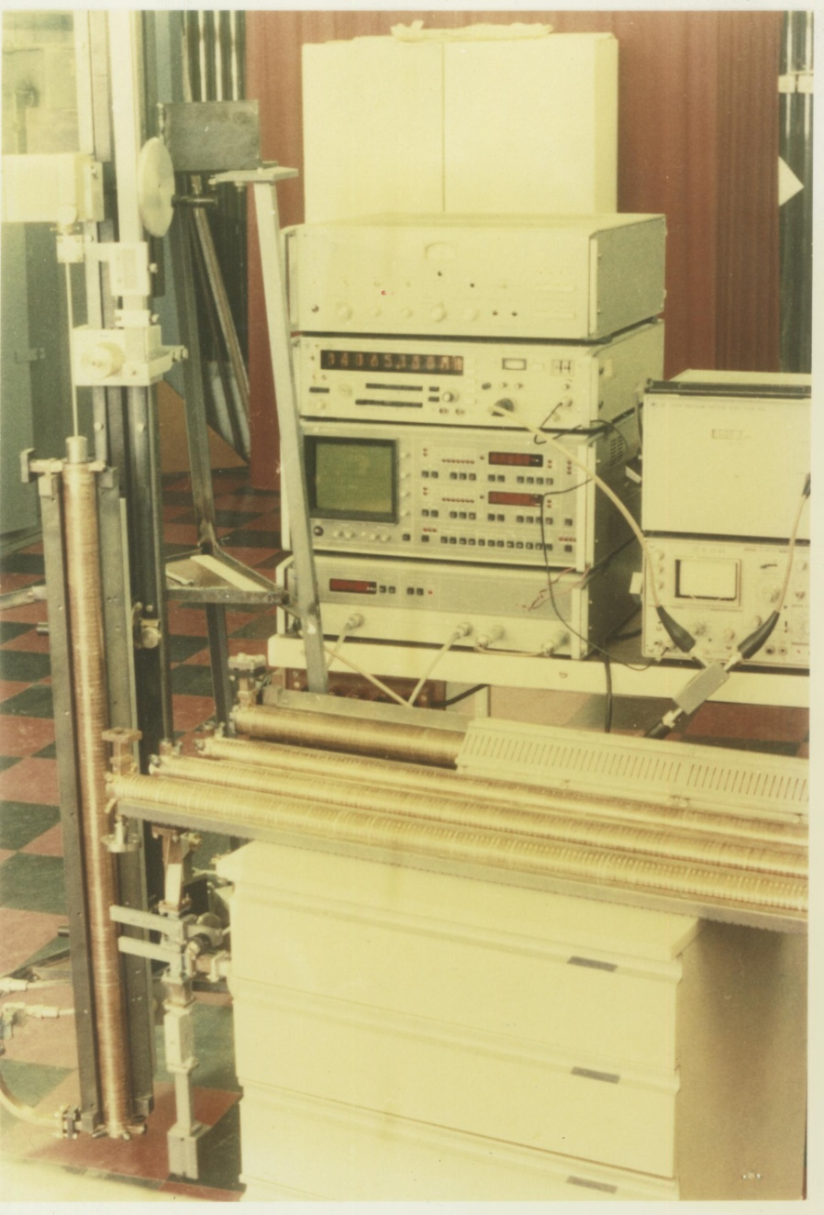
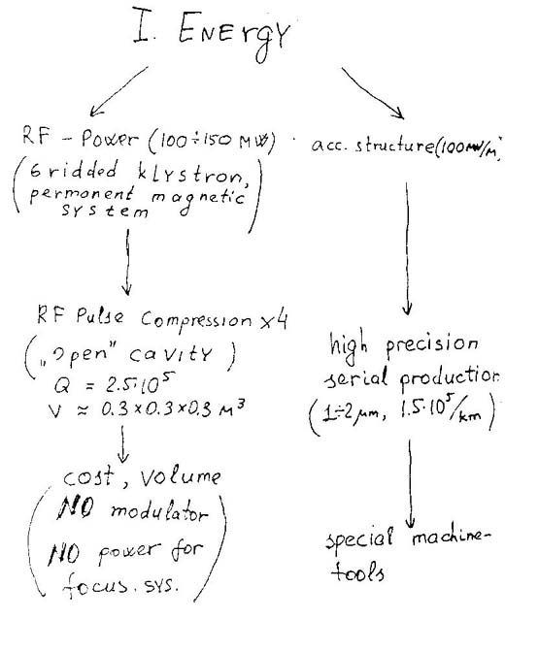
VLEPP based on 100 MV/m in LC91

Slide 6
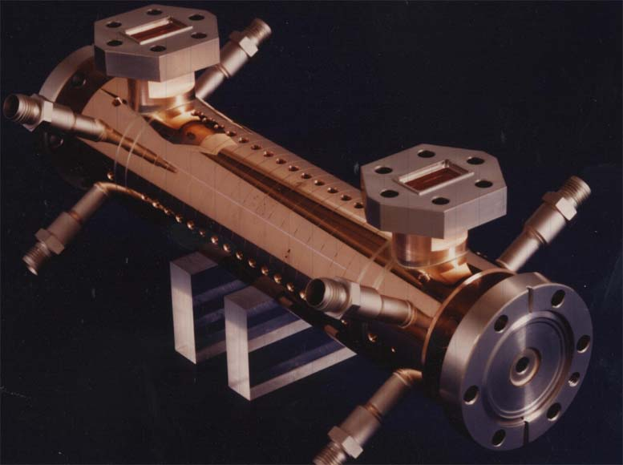
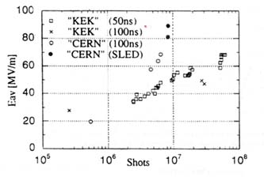
CERN made 20cm vg/c=1% structure tested up to 100 MV/m in early 90’s
90 MV/m with SLED at KEK
>100 MV/m at SLAC

Slide 7
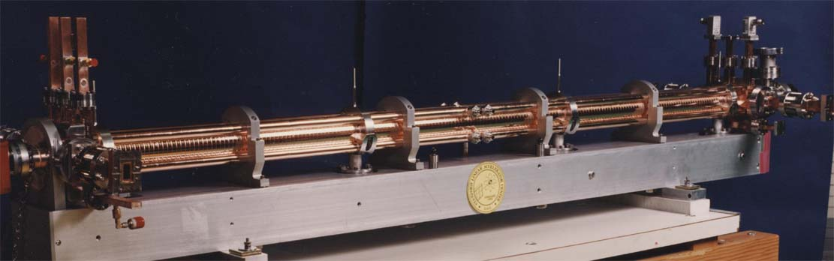
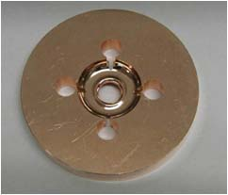
DDS scheme was confirmed in mid. 90’s sharp edges in its cells→ no high gradient test
1.8m RDDS1

Slide 8
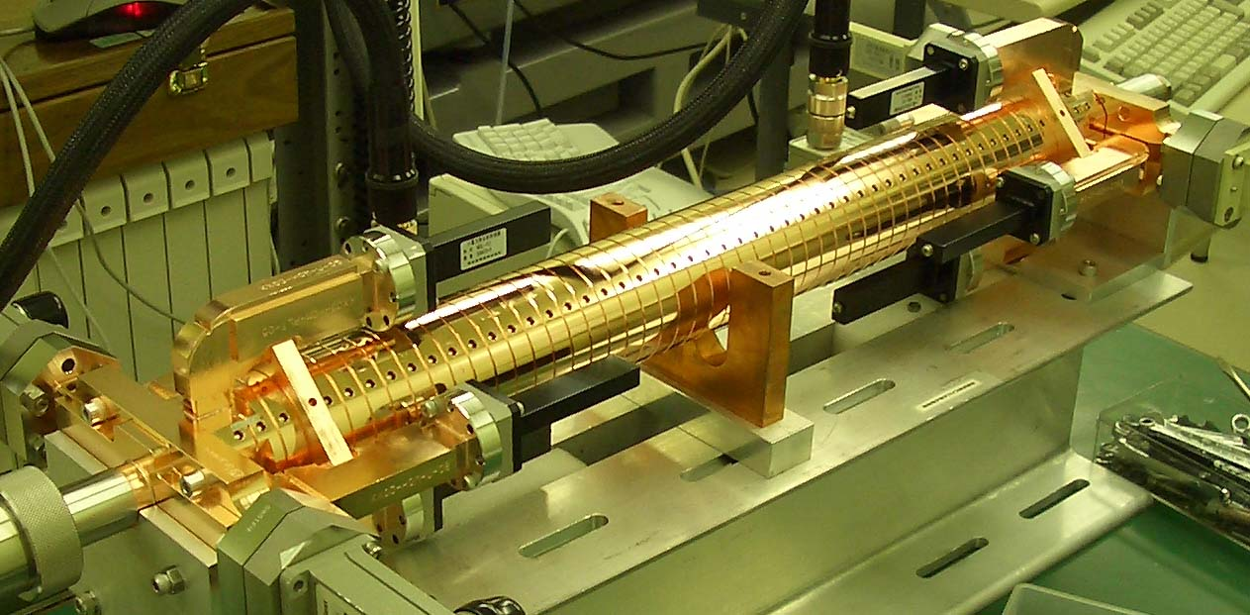
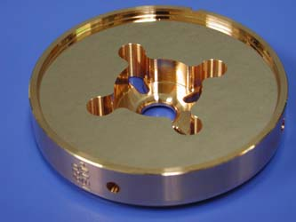
Many of the HDDS 60cm structures were made and tested in collaboration among SLAC, FNAL and KEK in late 90’s till 2004
Unloaded 65 MV/m was established in wake-field suppressed structures.
These opened a base which extended to
→ CLIC 100 MV/m design choice
→ medium-gradient applications

Slide 9
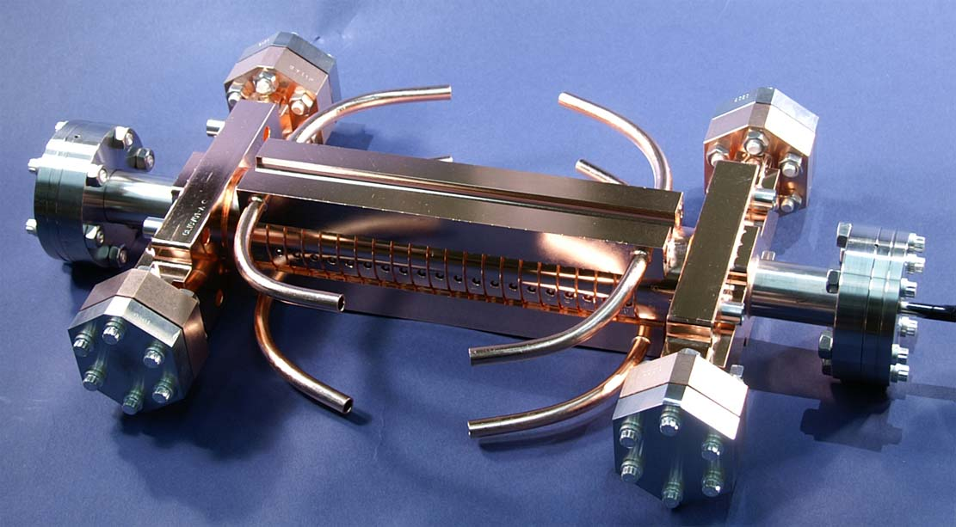

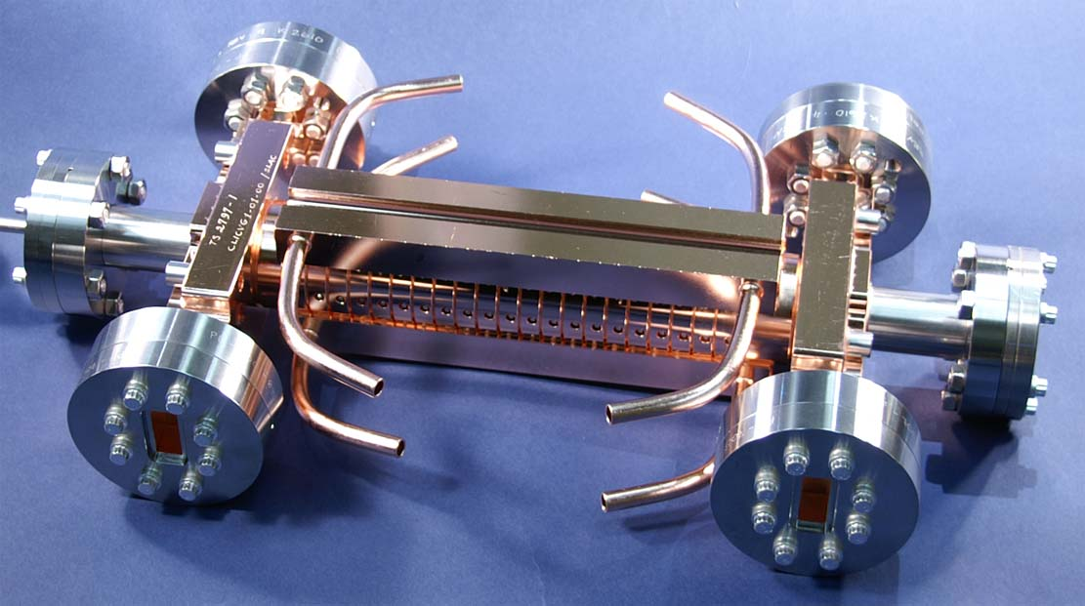
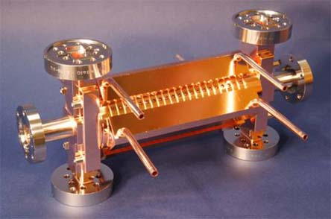
Series of CLIC test structures made as twins
Targeting 100 MV/m
In collaboration among CERN, SLAC and KEK

Slide 10
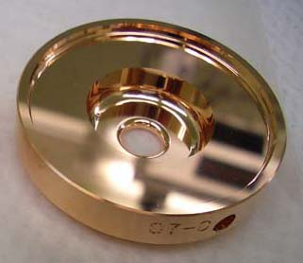
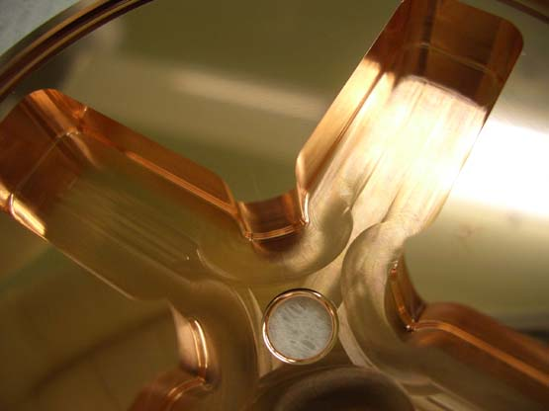
Cell shape evolution

Slide 11
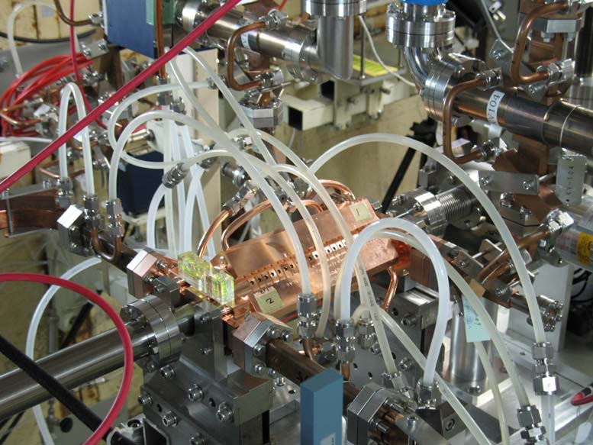
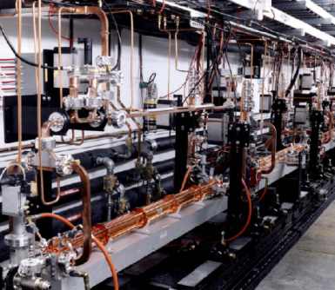
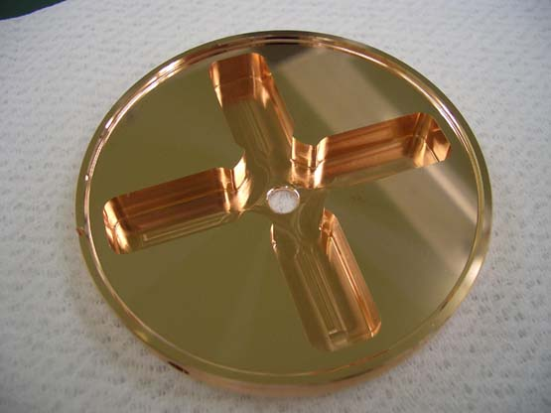
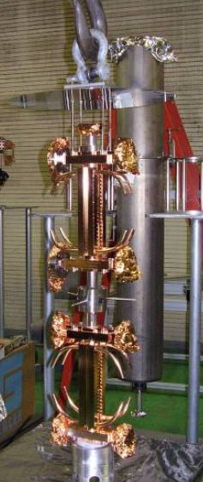
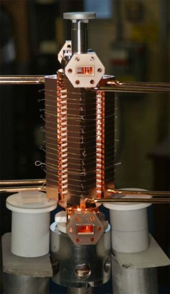
Nominal test procedure
Design for CLIC (CERN)
High power test (NLCTA-SLAC)
High power test (Nextef-KEK)
Fabrication of parts (KEK)
CP (SLAC)
VAC bake (SLAC)
Bonding (SLAC)
Two structures are made and treated as the twin for the evaluation.

Slide 12
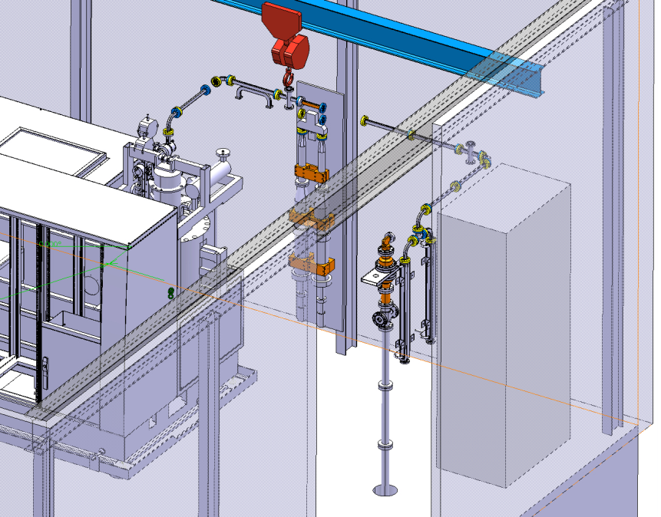
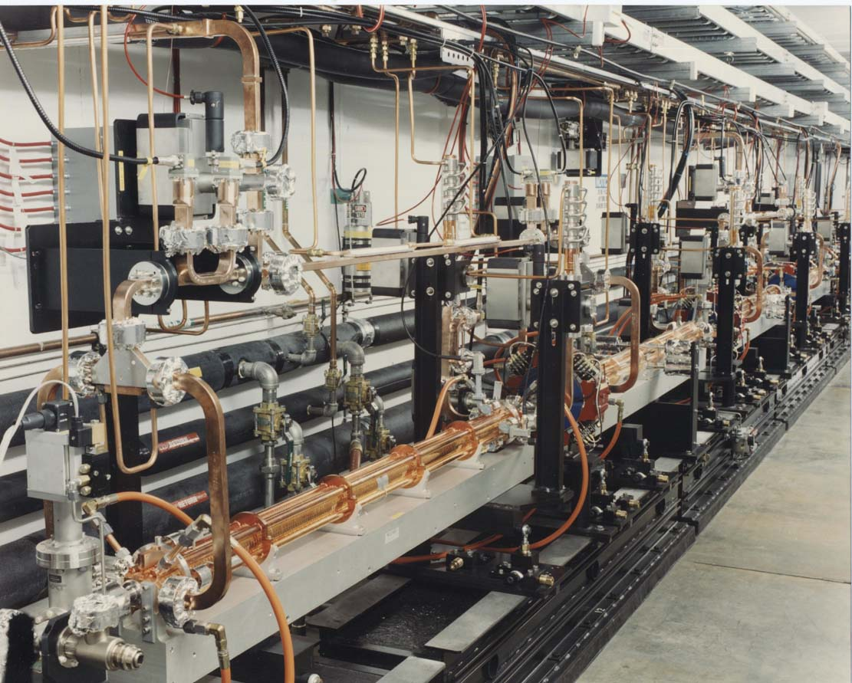
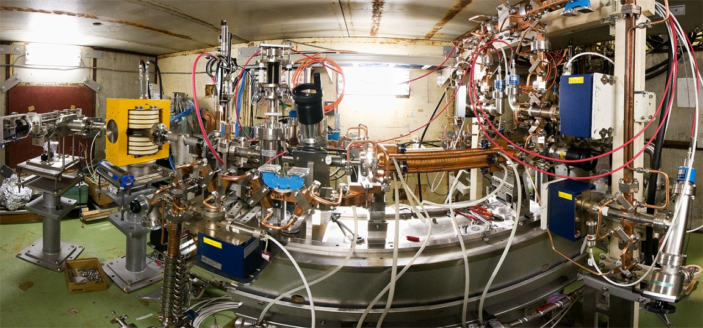
Three existing test facilities and one under construction at CERN
1, 2
NLCTA & ASTA at SLAC
4
CERN X-band test stand
K. Shirm in May 2010
CERN - CEA – PSI – SLAC
3
Nextef of KEK

Slide 13
Judgment with breakdown rate

Slide 14
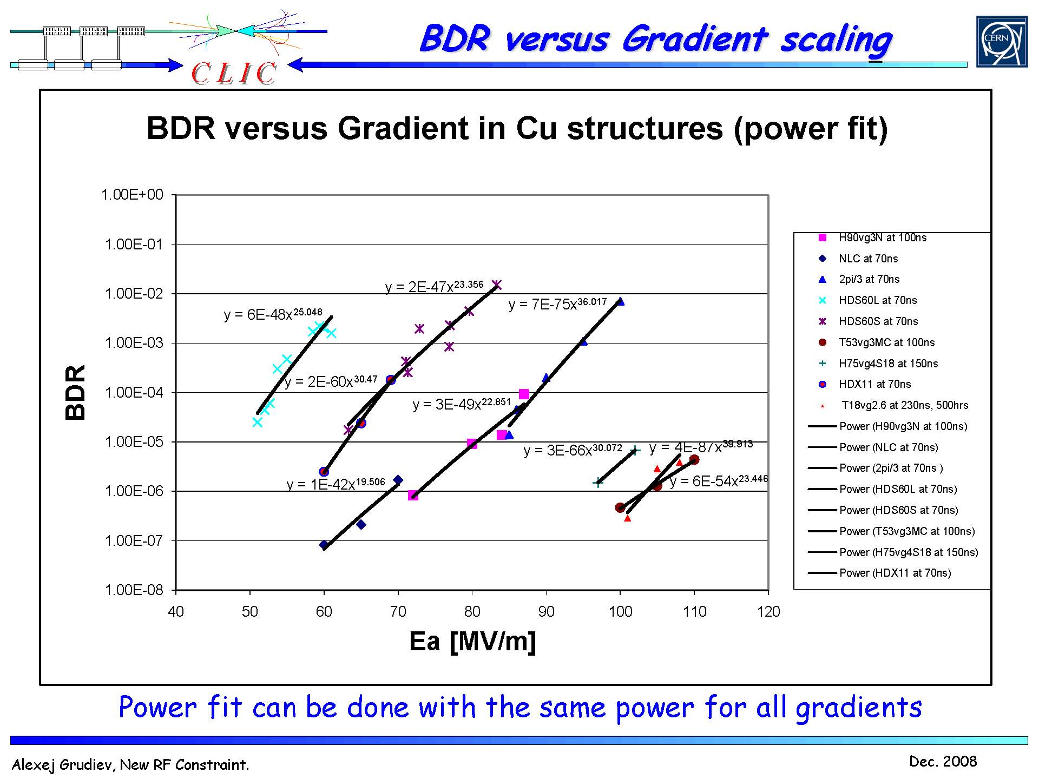
A. Grudiev, Dec. 2008
Some NLC/GLC structure performance well in short pulse
90㎝
75㎝
60㎝
53㎝
Notes:
Various GLC/NLC structures
HDDS 60cm structures
HDDS 75cm and 90cm structure
T53 undamped structure with MC coupler

Slide 15
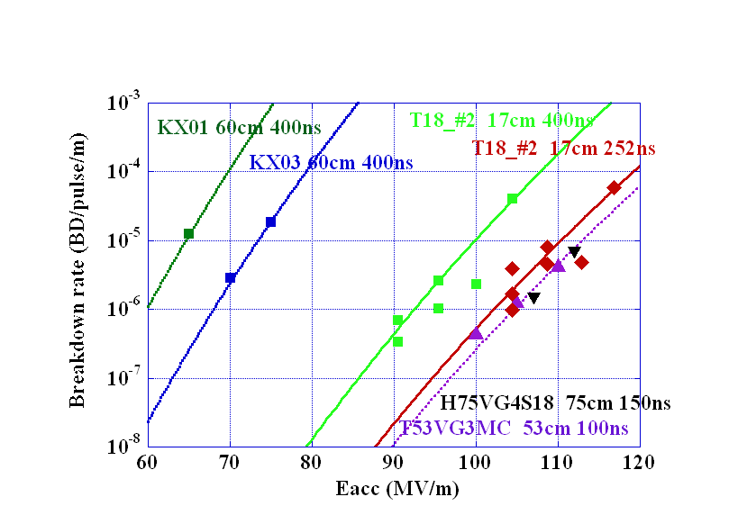
Possibility of 65 → 100 MV/m
BDR: promising result in CLIC prototype structure
CLIC undamped T18
Notes:
GLC 60cm HDDS structures at 400nsec
H75 at 150 nsec
T53 at 100 nsec
T18 20cm structure, undamped, for CLIC
We expect advancement from 65 MV/m → 100 MV/m

Slide 16
BDR of CLIC prototye but undamped structures
T18 tested at SLAC
T18 tested at KEK
T18_SLAC_2
A pair of the same structures are tested in different laboratories.
Both agrees after nominal processing period.
BDR decreases as processing proceeds.
Not yet completely stable. Need study more.
Notes:
BDR
BDR decreases as processing
Steep Eacc dependence Ea ^ 30
Pulse width dependence W ^ 6

Slide 17
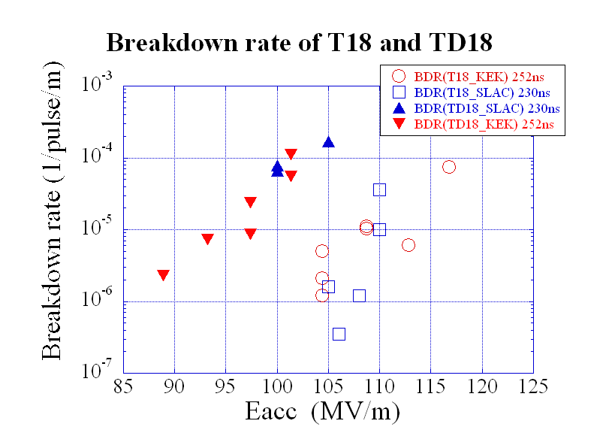
BDR: Undamped T18 → Damped TD18
T18 vs TD18
Undamped vs Damped
SLAC vs KEK
Sensitive to Eacc (Es, Hs)
~ X5~10 / 5 (MV/m)
BDR(damped)
~ 100 X BDR (undamped)
To be studied!
Damped structure:
High ΔT
Any other mechanism?
Notes:
Undamped → damped
BDR 10^1~2 higher
Meeting CLIC BDT criteria
T18 at 100 MV/m
TD18 at 90 MV/m

Slide 18
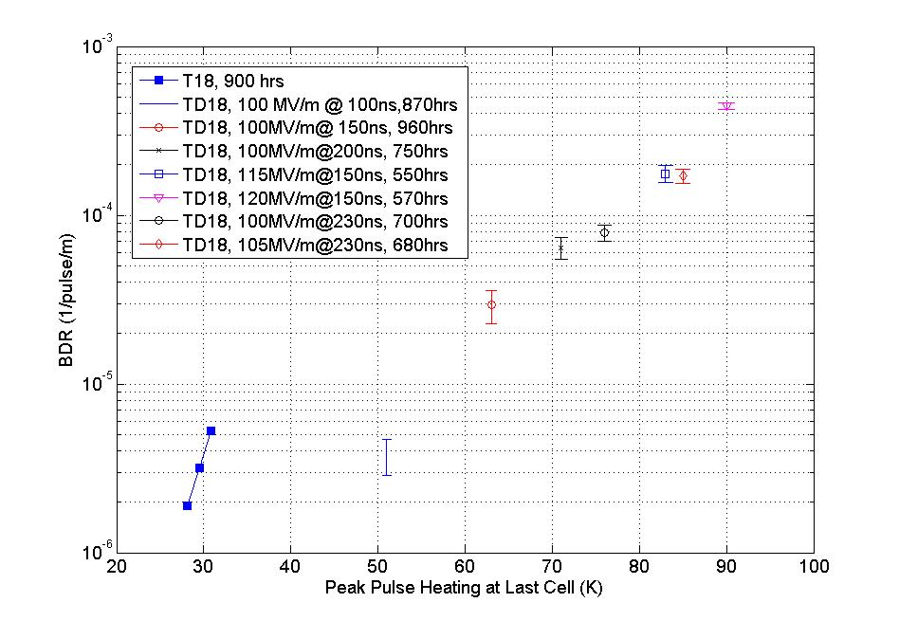
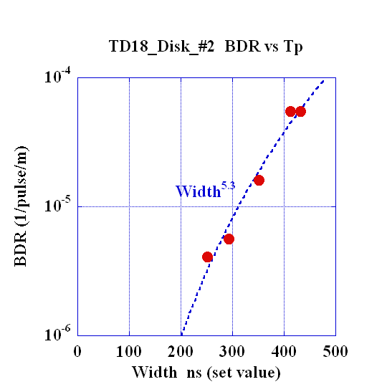
BDR versus RF width or ΔT(pulse heating)
TD18_Disk_#3
BDR versus ΔT
(pulse temperature rise)
TD18_Disk_#2
BDR versus pulse width
Damped
Undamped
Tight correlation with pulse temperature rise.
Same at 100MV/m but pulse length → ΔT
Same ΔT 83~84 degC but diff. Eacc
Similar correlation with pulse width.
Notes:
BDR scales as surface temperature rise??

Slide 19
Supplemental high-gradient studies
DC arc at CERN → Calatroni MOP070, Yokoyama MOP075
Waveguide RF at SLAC and KEK
Single-cell SW at SLAC → Valery talk FR105
Pulse heating at SLAC → Laurent MOP076
CZ 10-cell setup at SLAC
Some of these are presented in the following talk by Valery

Slide 20
Valery, 100613 AAC
Breakdown rate for 5 single cell SW structures
1C-SW-A2.75-T2.0-Cu-SLAC-#1 (green empty diamond), 1C-SW-A3.75-T1.66-Cu-KEK-#1 (black solid circle),
1C-SW-A3.75-T2.6-Cu-SLAC-#1 (blue empty triangle), flat part of the pulse 200 ns, and
1C-SW-A5.65-T4.6-Frascati-#2 (red empty circle), and 1C-SW-A5.65-T4.6-Cu-KEK-#2 (red full diamond) ), flat part of the pulse 150 ns
BDR
ΔT
Notes:
Effect of Delta_T plays an important role

Slide 21
Effort with parameter optimization for stable high gradient

Slide 22
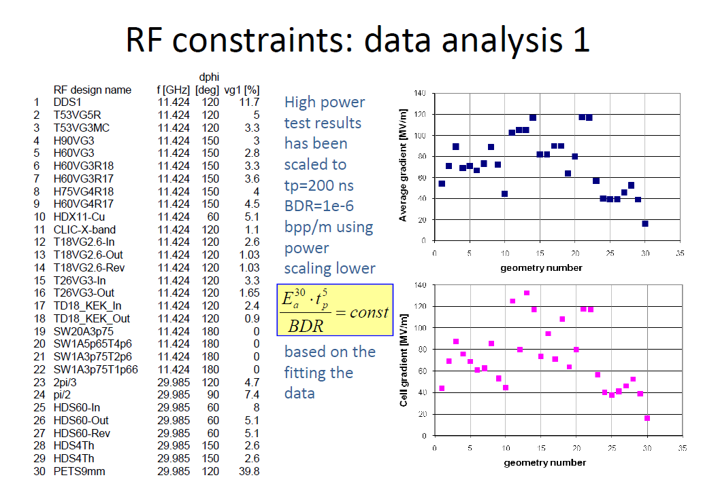
Grudiev, 100621 at FNAL
Compilation

Slide 23
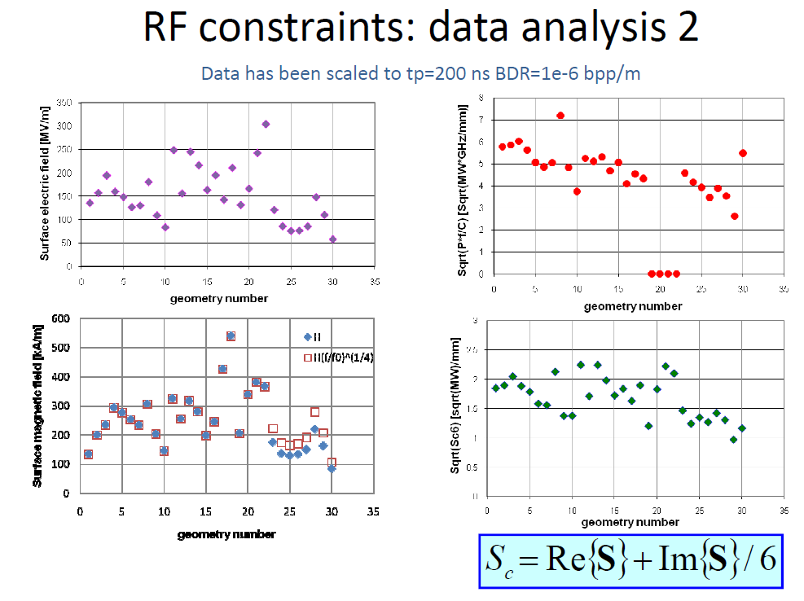
Sc
Grudiev, 100621 at FNAL

Slide 24

Unloaded 100MV/m
T18 TD18
From Grudiev, May 2010 4th WS at CERN
ΔT
T18 unloaded
100MV/m
TD18 unloaded
100MV/m
Es
Sc
Sc
P (MW), Es (MV/m), Ea (MV/m), ΔT(C), Sc*50 (MW/mm2)
Es
P (MW), Es (MV/m), Ea (MV/m), ΔT(C), Sc*50 (MW/mm2)
Ea
Ea
P
P
ΔT
ΔT
Iris number
Iris number
Notes:
T18 happened to be higher in Ea, Es, Sc, DT toward downstream
TD18 much higher delta_T comparing to T18

Slide 25
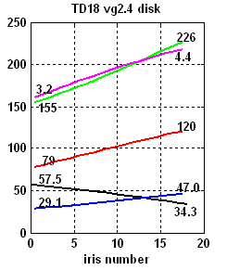
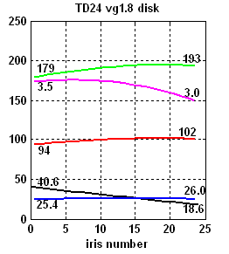
Acc mode parameters TD18 → TD24
From Grudiev, May 2010 4th WS at CERN
Tested
To be tested
Both Sc and ΔT decreased
by taking cell parameter optimization
Notes:
From 18 → 24
In addition, cell shape parameters are tuned to make flat delta_T

Slide 26
Effort with other HOM damping scheme

Slide 27
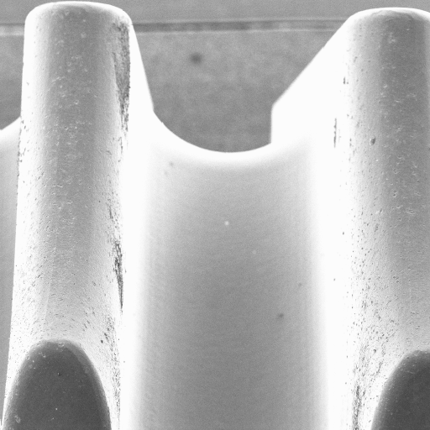
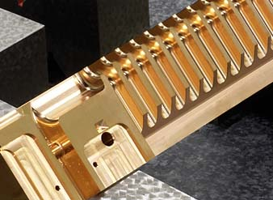
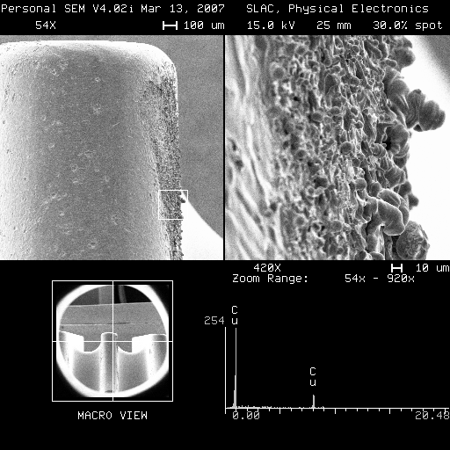
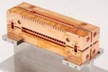
Consists of rods, quads or halves
Still poor high gradient performance.
Adolphsen, CLIC09, 2009

Slide 28
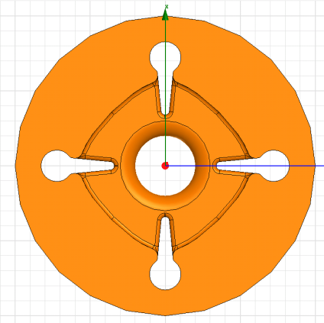
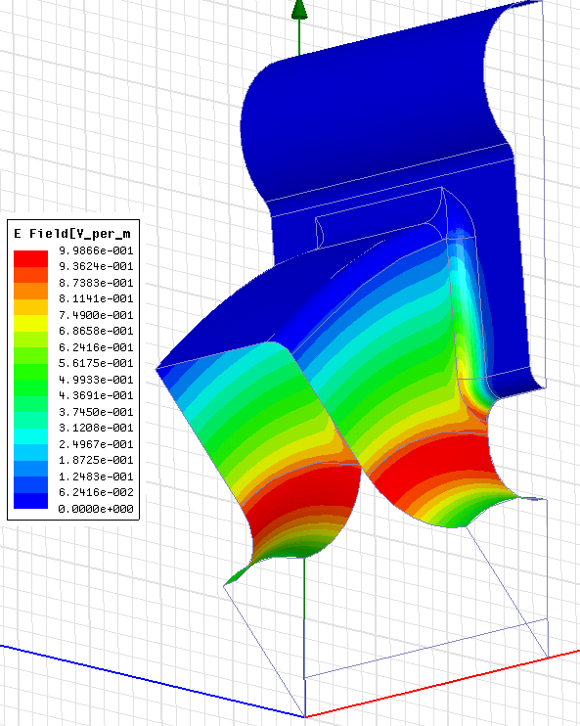
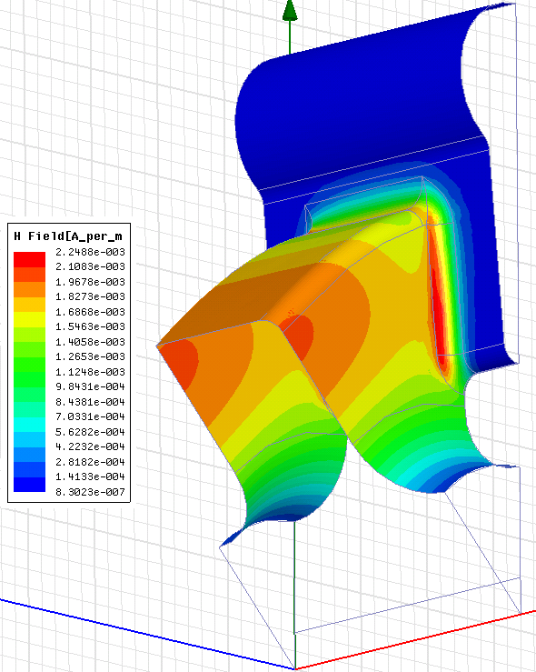
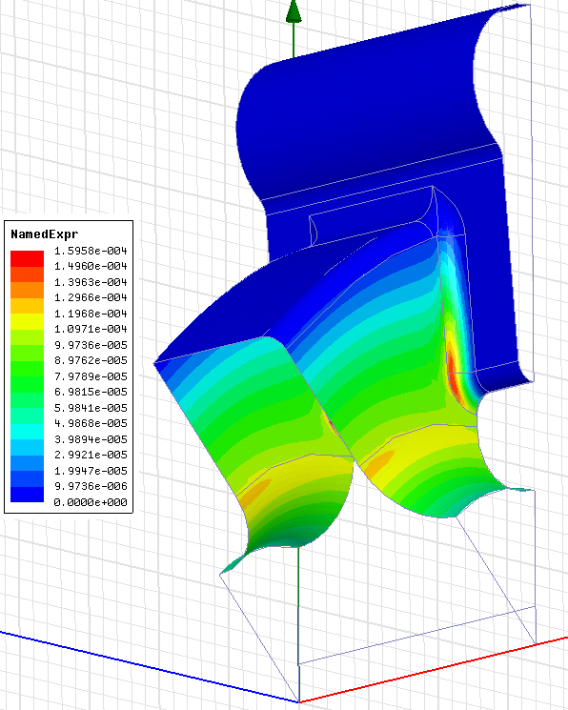
R. Jones for CLIC DDS design, 100911
DDS scheme for CLIC
Fabrication test was started.
May evaluate high gradient performance and wake field.
E-field
H-field
Sc
40 º K
50 º K
6.75 W/μm²

Slide 29
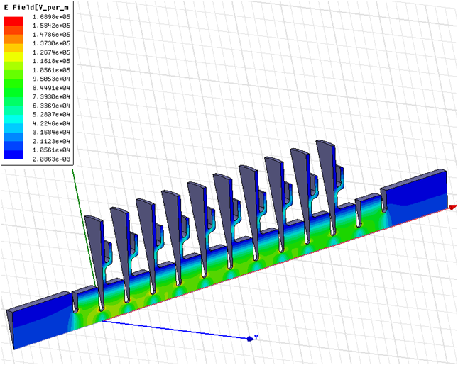
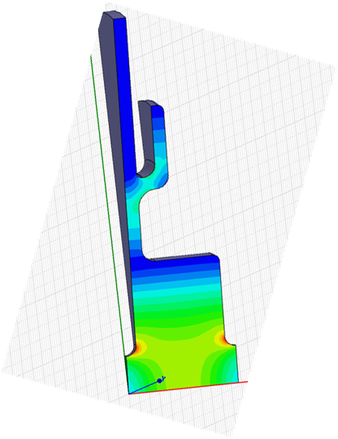
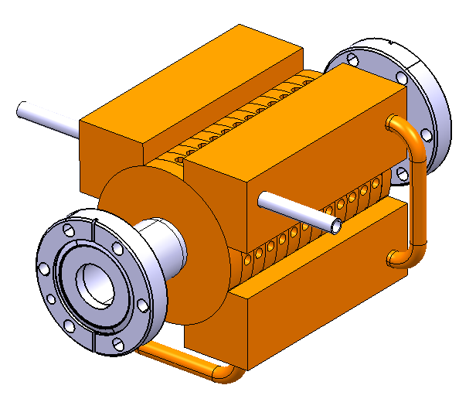
Choke-mode design
J. Shi CLIC choke mode design, 100913
Possible test in C10 setup
Design with choke mode
CLIC collaboration with Asia
Design in collaboration with Tsinghua U.
High gradient test at KEK

Slide 30
Efforts in fabrication technology
Before
  CERN: diamond-tool machining + vacuum brazing
  SLAC/KEK: technology hydrogen diffusion bonding + vac baking
Present to future
  Collaboration among three
  CERN follows SLAC/KEK to understand
    CERN-made T18 runs well, <2x10⁻⁷ BD/pulse/m (CLIC req.)
  Technologies are developed which can be realized at multiple places

Slide 31
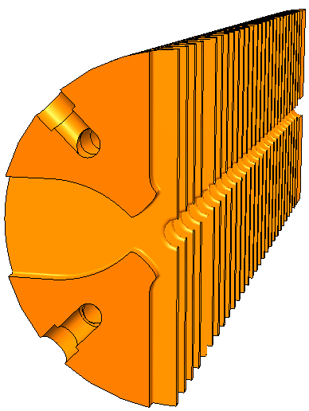
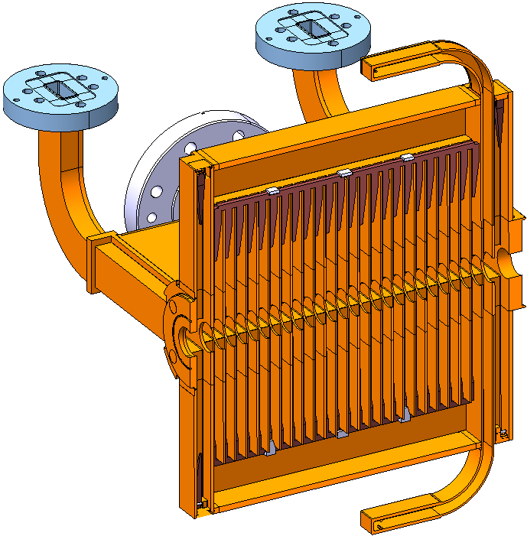
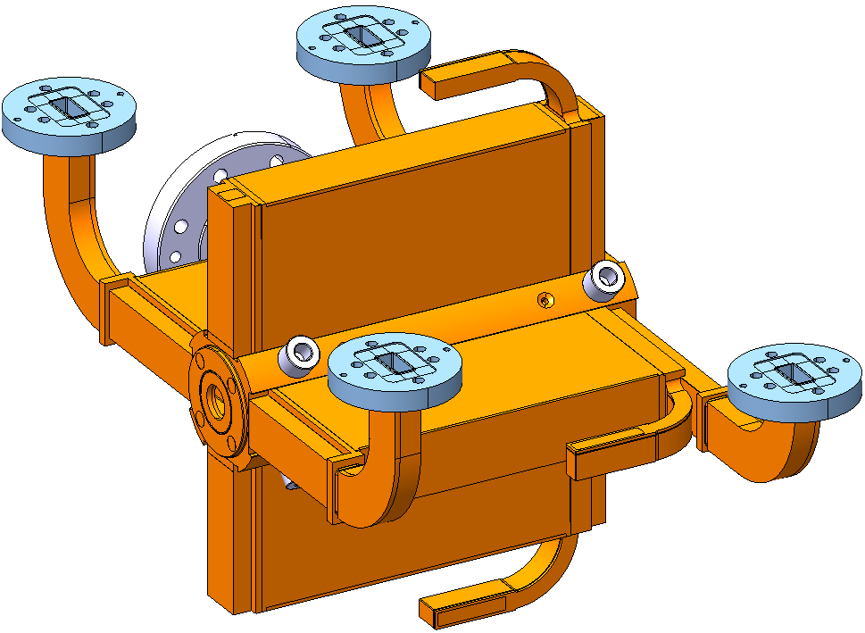
G. Riddone, CERN, 100914
TD 26 ( CONCEPTUAL DESIGN )
DAMPING MATERIAL
11.994 GHz, damped structure, 26 cells, asymmetric disk (Ø80 mm), external diameter reference, internal cooling.
VACUUM MANIFOLD
LOADS CONNECTION
RF
COOLING CIRCUIT
RF
LOADS CONNECTION
RF
DISTRIBUTION
BEAM
REF. SHPERES
WAVEGUDE WITH WFM & DAMPING MATERIAL

Slide 32
Assembly of accelerating structures
G. Riddone, 06/09/2010
CERN strategy
T18 structures tested at SLAC/KEK
showed excellent test results
consequent validation of
design, machining and assembly procedure
NLC/JLC fabrication technology: validated to
100 MV/m (baseline for future CERN X-band accelerating structures)

Slide 33
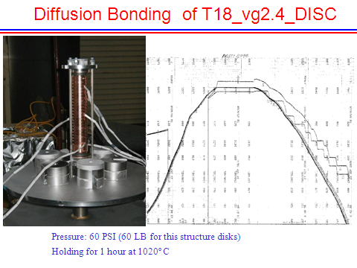
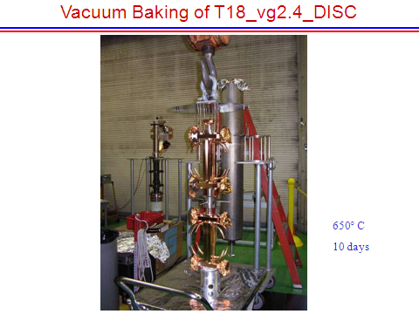
Baseline procedure
G. Riddone, 06/09/2010
Diamond machining (sealed structures)
Cleaning with light etch
J. Wuang
H2 diffusion bonding/brazing at ~ 1000 ˚C
Vacuum baking
650 ˚C > 10 days
J. Wuang

Slide 34
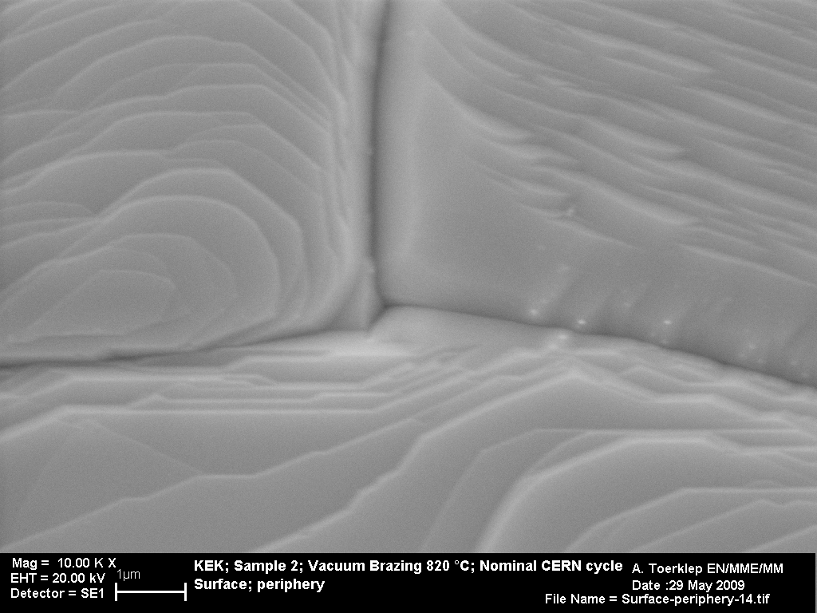
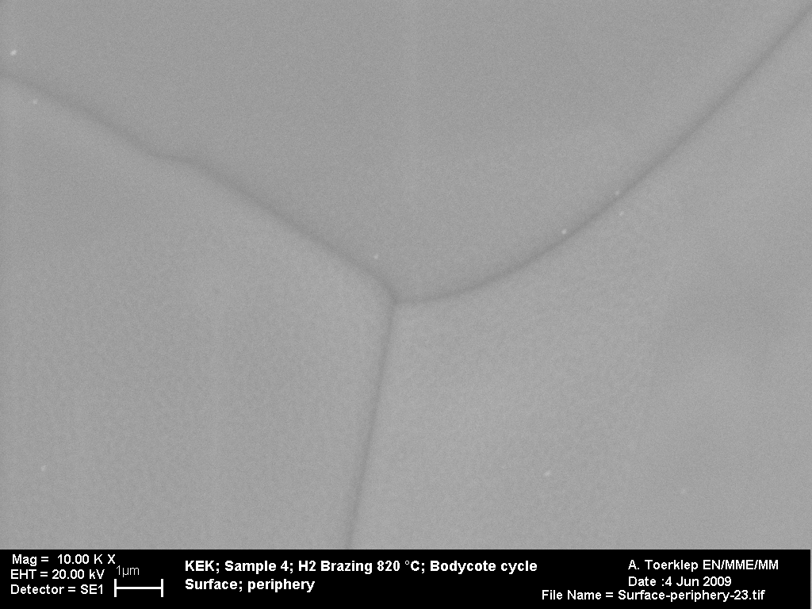
Vacuum brazing versus hydrogen brazing
One of the key differences
G. Riddone, 06/09/2010
Vacuum brazing
Hydrogen brazing
Extensive program launched to improve our understanding on the influence of different thermal cycles on the copper surface

Slide 35
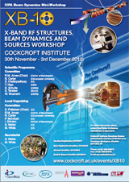
X-band collaboration
CLIC
CI @ UK
In 2010
CERN & European labs.
Design & fabrication
High power test @ CERN
CERN/KEK collaboration
etc
CERN/SLAC collaboration
US-HG
Asian collab.
KEK / SLAC
SLAC conducts
Structure fabrication
High power test @ SLAC
Basic research
KEK, Tsinghua, IHEP
Structure design & fabrication
High power test @ KEK

Slide 36
Conclusion
CLIC BDR requirement
  CLIC undamped structures T18 meet at 100 MV/m
  CLIC damped structures TD18 meet at 90 MV/m
  Need to confirm the long-term stability
Important parameters were identified
  Such as Sc and ΔT
  New designs were made and to be tested in 2010
Fabrication technology
  SLAC/KEK scheme is being reproduced by CERN
  Problems are identified to be improved
X-band collaboration
  Worldwide collaboration is expanding centered at CLIC but also in other applications

